Slide 1

TimeTable Publisher
Frank Purcell
TriMet
Presented @ TransITech
February 14, 2007

Slide 2
Presentation Overview
Introduction to the TimeTable Publisher
Brief History of the Project
Project Status
Open Source Questions

Slide 3
What
System that produces Timetables in various formats.
Raw scheduling data requires preparation for public use that is normally a very tedious and time-consuming manual process for most transit agencies.
The TimeTablePublisher is a single system that takes raw scheduling data as input from various sources, and outputs timetables into various formats for public use.

Slide 4
History
Transit Forum Workshop – October 2005
Origins: Dynamic Timetable Generator
DTG Chosen as a trial open source project last October
Polly Okunieff deserves credit for this earlier work
Replaces Legacy System @ TriMet
Started March 2006. First release September 2006

Slide 5
Information Flow
Raw
Schedule
Data
TimeTable
Configuration
Schedule
Writer
Marketing
TimeTable Publisher
WEB
PRINT PRODUCTION
HTML
PDF
PDF
Proofing
MS Excel
Adobe
InDesign XML

Slide 6
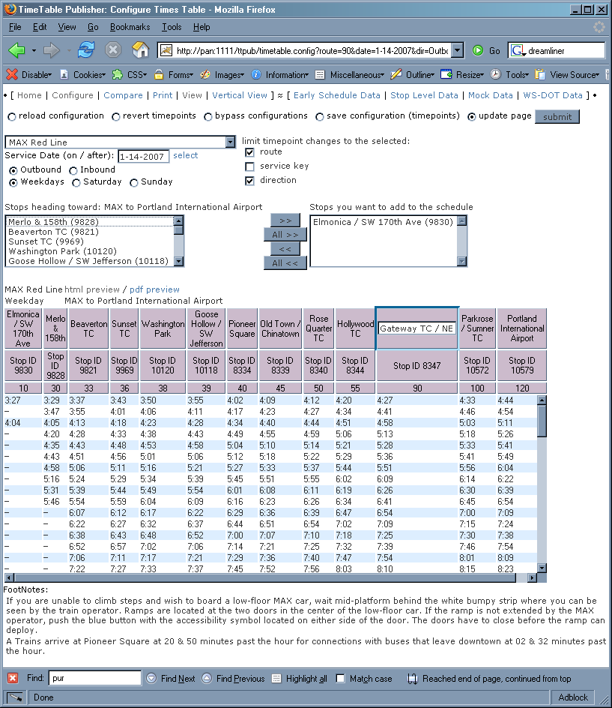
Configure Screen Shot

Slide 7
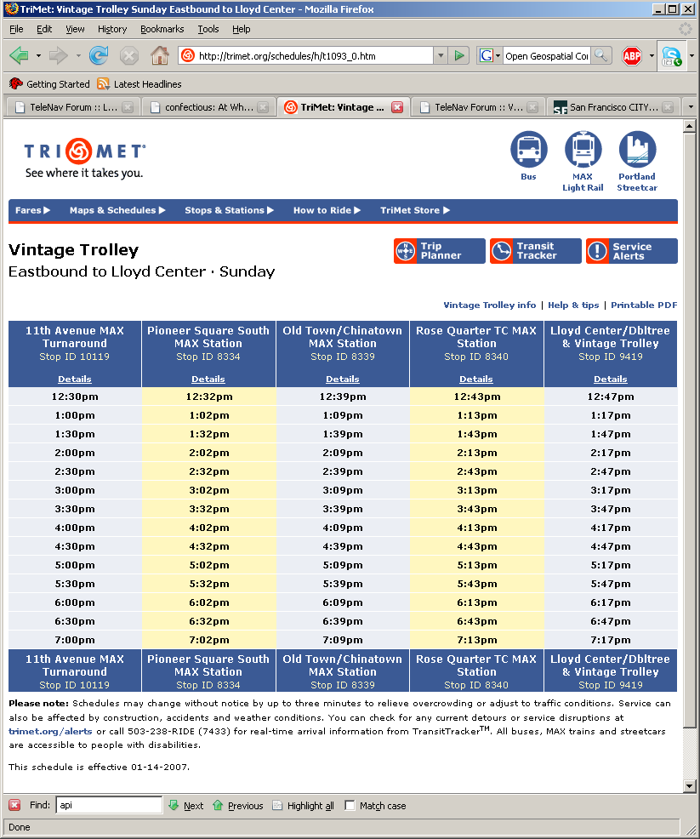
Web TimeTable Screen Shot

Slide 8
Project Status
Internal Release at TriMet
Printed Materials for January 14th 2007 signup
Web HTML & PDF Timetables – regenerated on a weekly basis
Future project phases are being considered
  Dynamic Web Application – Build your own TimeTable / Schedule Book
  TimeTables / Interactive Map Integration
  Operations Use: Sequence Book / Corner Cards
King County Metro and WA-DOT
Google Transit Feed Spec as a Common File Format
Tim Moore & Mike Berman (KING Co.); Marcy Jaffe (WA-DOT)
Looking to Release to Open Source

Slide 9
TimeTablePublisher 3C’s & 1G
Consistent: Single system for Print & Web output.
Control: Publishing transit information for public consumption is a Marketing task. The TimeTablePublisher gives the Marketing team full control over public schedule information.
Costs: Cost Reduction (realized at TriMet) from Automation & Repeatable Processes
Google Standardized data format lowers the barrier
Feed Spec: to using the TimeTablePublisher
Bottom Line: Better Information & Reduced Costs

Slide 10
Open Source?
Is it for Everyone?
  The TimeTable Publisher, like most software, open source or proprietary, will require some technical resource to install, run and maintain.
Is it really free?
  Yes, given the technical facilities and/or resources.
  But customizations and support will probably have costs.
Why do this (TriMet & my personal perspective)?
  - TriMet seeks maintainers and other developers who may contribute something new & compelling, which will ultimately benefit TriMet.
  - Personally, I use a lot of open source tools & SW, and am happy to contribute something in return.

Slide 11
END
Contact: purcellf@trimet.org Visit: http://timetablepublisher.org http://groups.yahoo.com/group/TransitForumNet

Slide 12
Java Technologies Used
Where | Technology | Comment
HTML & XML | FreeMarker | Essential tool: templating language for Java. You put Java beans (or collections of beans) on the FreeMarker stack, and dispatch control to your FreeMarker template. Within the template, you mix static text & markup with content from your beans (in this case TimeTable interface objects), to build a page. FreeMarker is run both as POJO to batch generate content, as well as within TimeTable Pub’s online configure & view tools
 | FreeMarker Servlet | Part of FreeMarker – allows templates to be used as dynamic web pages, where control hits servlet first & template second, ala the MVC Model 2 pattern.
 | Java Script | A fair amount of Java Script was used in the Configure Tool.
PDF | iText | Java library for generating PDF files. Like FreeMarker templates, iText code understands how to traverse the objects that make up our abstract TimeTable data interface.
Data Tier | OpenCSV | Great little library for reading & writing CSV files.
 | Hibernate | Object to relational binding, used in this project to read data from the database. Main advantages are 1) queries return data into java objects, as opposed to clunky result-sets, 2) built-in object caching and connection pooling, 3) automated code-generation of bindings.

Slide 13
Construction Technologies Used
When | Technology | Comment
Development | Eclipse | Really need an editor with auto-completion and refectoring tools, especially using hibernate. Plus, Eclipse has is a database viewer, hibernate binder (big time saver), revision control, and a J2EE debugger etc… Just a vital tool.
 | emacs | Quick & dirty editor that complements Eclipse.
Build Time | Apache Ant | The entire build, from code-gen to compile to .war deployment is handled by Ant…making the build process easily repeatable.
 | Hibernate Tools | Hibernate Tools is used to reverse engineer relational tables into objects and their O/R bindings, freeing up a lot of time that would otherwise be spent on building & maintaining plumbing code.
Run Time | Hibernate | Converse with a database entirely via JavaBeans.
 | Java 5.0 | Heavy use of Generics (eg: Parametized Types / Templates), to add type clarity to Container objects. 5.0 Enums are also a used quite a bit. An Annotation used sparingly (but these are very cool in certain circumstances).

Slide 14
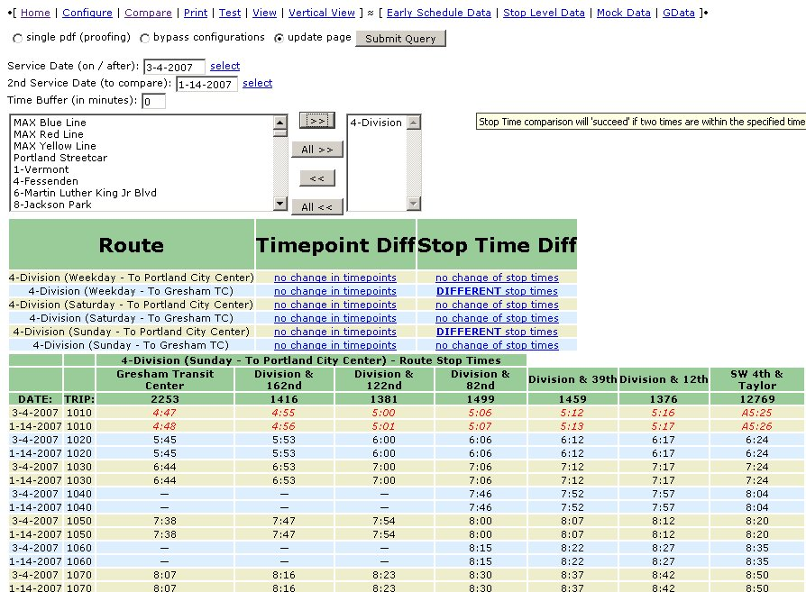
Compare Screen Shot

Slide 15
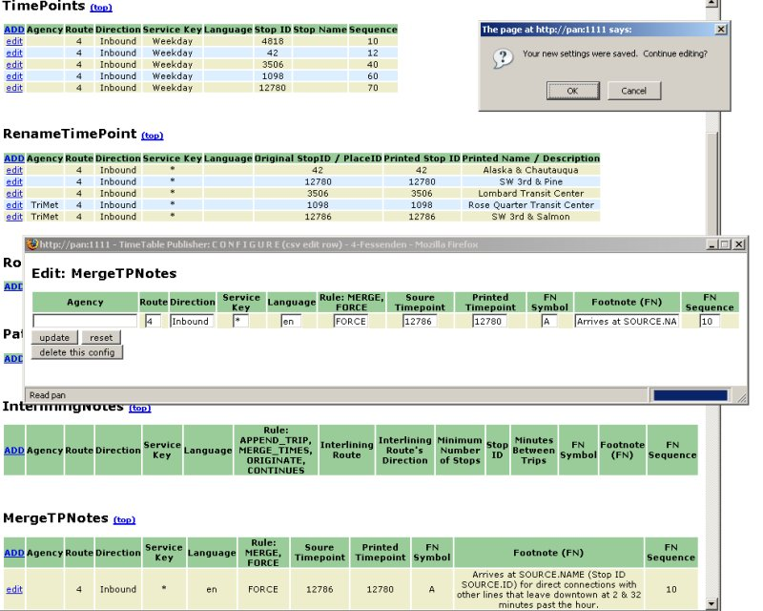
Configure Screen Shot

Slide 16
Components of the Application
Schedule Data Import
The TimeTable Publisher can source data from both a database or from a set of files (eg: CSV or XML).
The system has built-in functionality to read the Google Transit Data Feed CSV format (the data format being used for Google Transit).
Custom data adapters can also be built. These adapters extend and reuse existing system interfaces in an effort to reduce the work necessary to get a custom data format into the system.
Configure Tools
More esoteric configuration parameters are controlled via structured data files in the CSV (comma separated value) format.
The entire configuration can be viewed and edited with common desktop applications (eg: Microsoft Excel).
A user interface is provided to allow the user to build timetables out of raw scheduling data.
A web tool allows the user to edit which timepoints appear on a table. This web tool also provides a view into the complete configuration.

Slide 17
Components of the Application
Output Tools (includes batch and real-time generation of data). Timetables are published in the following data formats: XML, XML (for direct import into Adobe InDesign), HTML, PDF, Text
  The TimeTable Publisher can act as either a web application in real time, and/or run as an offline batch file processor, where a ZIP file of timetables is published in one or more of the file formats above.
  A command line tool is provided to create a ZIP file of timetables in their specified format. A web based batch generator (tool to generate ZIP files via a web interface) is similar to the command line batch file generator.
  Web based interface for a real-time view of the data
  Output in PDF or HTML (could be a customer facing web application)
Compare Tool: used to perform various comparisons between two service dates to determine the changes made and differences between the two schedules.
Multi Agency Tool: Design goal is for multiple transit agency use. This tool is not tied to TriMet's data model -- there is a generic model of a timetable that TriMet's data (and potentially other agencies’ data) is translated into. Minimal effort (e.g., little to no coding) to get another agency's scheduling data flowing through this system and generating timetables.
Google Transit: With the advent of Google Transit -- and more importantly, multiple agencies generating data for Google Transit in a common format -- this tool will leverage the Google Transit Feed Specification file format (which Google intends to make an open standard) as a primary data input for raw scheduling data.

Slide 18
Sequence – Rendering a TimeTable
View / Controller
FreeMarker (html)
iText (pdf)
TimeTable
Configure
Raw Schedule
1
2
3
4
Customer
5
6
7
8
Notes:
Sequence – from request to rendering:
Customer requests to view a time table.
The Controller will create a TimeTable object (data access interface, representing TimeTable Pub’s internal structure of scheduling data).
In constructing the TimeTable object, Raw Scheduling data is pulled…
And the needed Configuration data is also pulled…
The TimeTable will shape the Raw data with help of the Configuration…
The configured data is now made available via the TimeTable interface to the Controller.
The controller then sends the TimeTable interface over to the View (FreeMarker for HTML or iText for PDF) for rendering into a document.
The controller ends the sequence by sending the rendered View back to the customer.

Slide 19
Swimlane – TriMet Print Prep
Presentation Layer
Creative Services
4
5
6
Freemarker/iText (web)
Zip File
XML TimeTables
Configure Interface
Freemarker (XML)
1
Adobe InDesign
Data Object Layer
TimeTable
Processing Steps:
The Configure Interface creates a TriMet instance of TimeTable
The TriMet TimeTable object / code queries raw data from DB.
Marketing (IDP) will be actively creating & editing a configuration that defines the timetable look.
Marketing uses a web-app interface, which renders TimeTable objects into either HTML (FM) or PDF (iText).
When timetables are ready for print, XML files are generated & zipped.
CS (Designers) pick up the XML, and import into InDesign for print layout
TriMet TimeTable
Configuration Layer
3
Define Time Points
Define Footnotes
etc…
Persistence Layer – Raw Scheduling Data
TRANS
2

Slide 20
Swimlane – TriMet Print Prep
Presentation Layer
5
Creative Services
Zip File
6
1
IDP
4
Configure Interface
PDF File
(proofing)
Designer
Adobe InDesign
Data Object Layer
TimeTable
Processing Steps:
The Configure Interface creates a TriMet instance of TimeTable
The TriMet TimeTable object / code queries raw data from DB.
Marketing (IDP) will be actively creating & editing a configuration that defines the timetable look.
Marketing uses a web-app interface, which renders TimeTable objects into either HTML (FM) or PDF (iText).
When timetables are ready for print, XML files are generated & zipped.
CS (Designers) pick up the XML, and import into InDesign for print layout
2
TriMet TimeTable
Configuration Layer
3
Define Time Points
Define Footnotes
etc…
Persistence Layer – Raw Scheduling Data
TRANS
2
Notes:
NOTE: IDP is the Technical Marketing Team at TriMet, who prep and manage print time-tables both on the street as well as publications.

Slide 21
Swimlane – TriMet Website
Presentation Layer
Web Destination
1
iText (PDF)
Zip File
5
Batch HTML & PDF
Generation
4
CRON
trimet.org
Freemarker (HTML)
Data Object Layer
TimeTable
Processing Steps:
The Batch Process creates a TimeTable instance for each of our routes / directions / service keys.
The TriMet TimeTable object / code queries raw data from DB.
That data is filtered by an IDP (Marketing) defined configuration, which culls time points, adds footnotes, footnotes trips, etc…
Each TimeTable is sent to view objects which render PDF / HTML
A resulting zip file is eventually picked up and moved to trimet.org
TriMet TimeTable
Configuration Layer
3
Define Time Points
Define Footnotes
etc…
Persistence Layer – Raw Scheduling Data
TRANS
2

Slide 22
Swimlane – TriMet Website
Presentation Layer
Web Destination
Batch HTML & PDF
Generation
4
CRON
Zip File
Customer
5
1
trimet.org
Data Object Layer
TimeTable
Processing Steps:
The Batch Process creates a TimeTable instance for each of our routes / directions / service keys.
The TriMet TimeTable object / code queries raw data from DB.
That data is filtered by an IDP (Marketing) defined configuration, which culls time points, adds footnotes, footnotes trips, etc…
Each TimeTable is sent to view objects which render PDF / HTML
A resulting zip file is eventually picked up and moved to trimet.org
TriMet TimeTable
Configuration Layer
3
Define Time Points
Define Footnotes
etc…
Persistence Layer – Raw Scheduling Data
TRANS
2

